Slide 1


Expected Work Goals
Part 5
Key Words:
Integrated model
Communication
Target Sensing
Model Computation

Slide 2

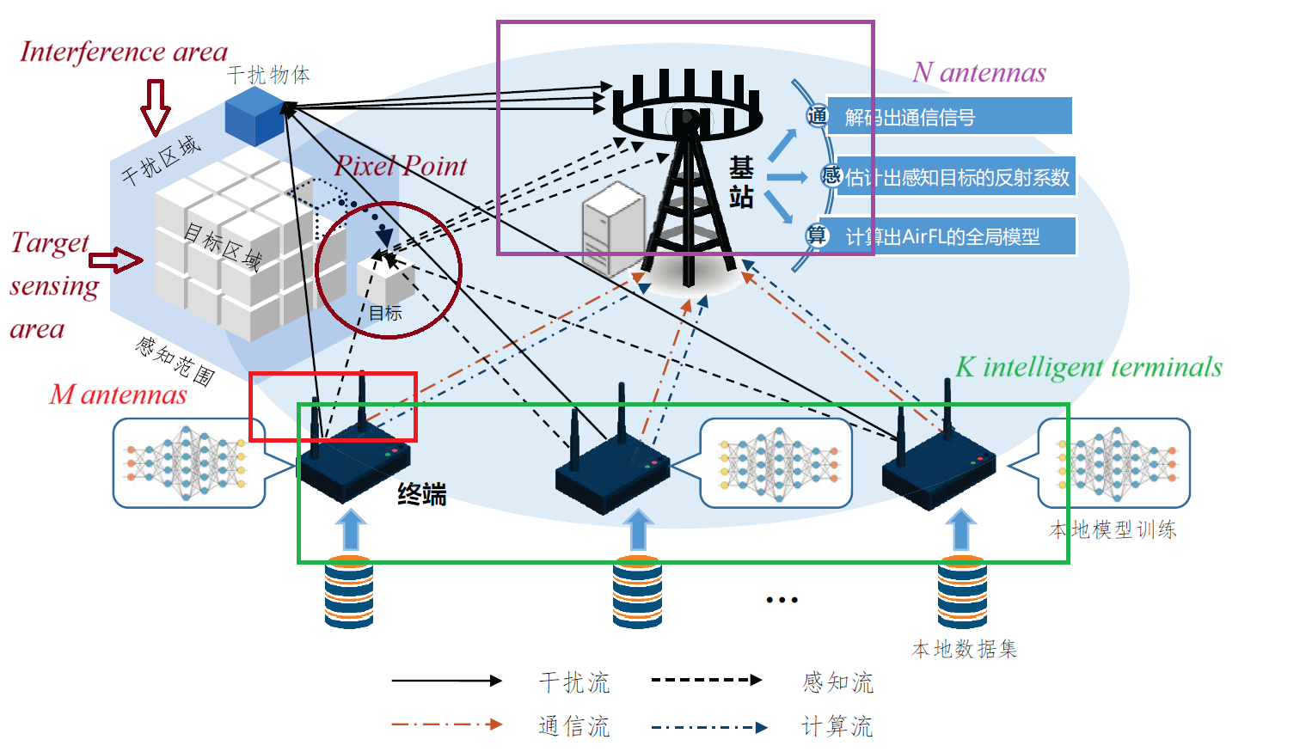
Expected Work Goals
Communication
Multifunctional Integrated Model
Target Sensing
Model Computation

Slide 3
Expected Work Goals

Slide 4
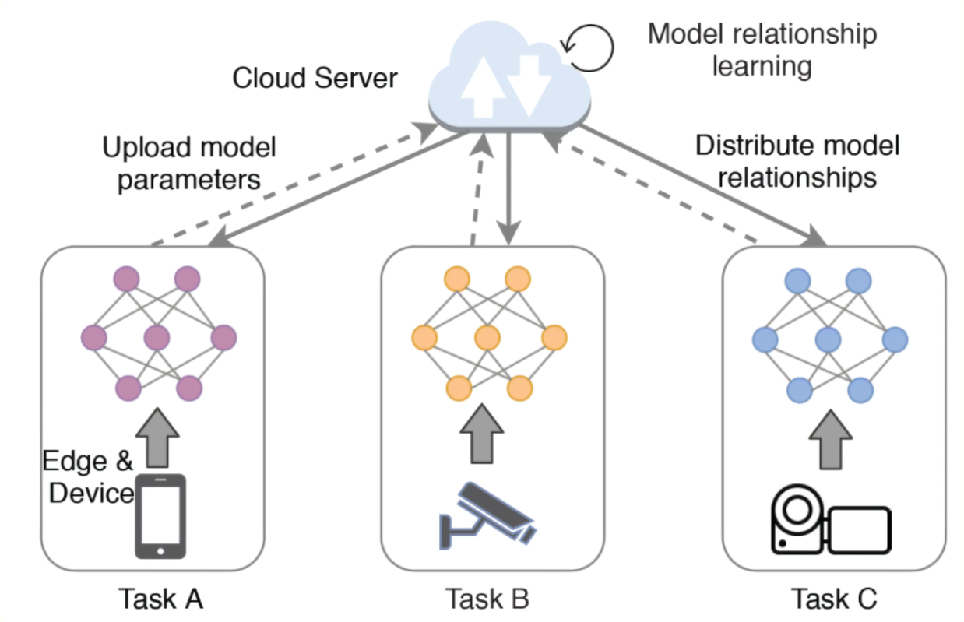
Expected Work Goals
Communication Signals
(Transmitted by the intelligent terminals)
COMMUNICATION
Communication
Receiver
Obtain the desired
communication data
Reflected Signals
(Contain environmental information)
TARGET
SENSING
Sensing
Receiver
Estimate the target’s reflection coefficients
MODEL
COMPUTATION
Computation
Receiver
Obtain a
global model

Slide 5
Expected Work Goals
Communication Signals
(Transmitted by the intelligent terminals)
COMMUNICATION
Communication
Receiver
Obtain the desired
communication data
Reflected Signals
(Contain environmental information)
TARGET
SENSING
Sensing
Receiver
Estimate the target’s reflection coefficients
MODEL
COMPUTATION
Computation
Receiver
Obtain a
global model

Slide 6
Expected Work Goals
Communication Signals
(Transmitted by the intelligent terminals)
COMMUNICATION
Communication
Receiver
Obtain the desired
communication data
Reflected Signals
(Contain environmental information)
TARGET
SENSING
Sensing
Receiver
Estimate the target’s reflection coefficients
MODEL
COMPUTATION
Computation
Receiver
Obtain a
global model

Slide 7
Expected Work Goals
Communication Signals
(Transmitted by the intelligent terminals)
COMMUNICATION
Communication
Receiver
Obtain the desired
communication data
Reflected Signals
(Contain environmental information)
TARGET
SENSING
Sensing
Receiver
Estimate the target’s reflection coefficients
MODEL
COMPUTATION
Computation
Receiver
Obtain a
global model

Slide 8
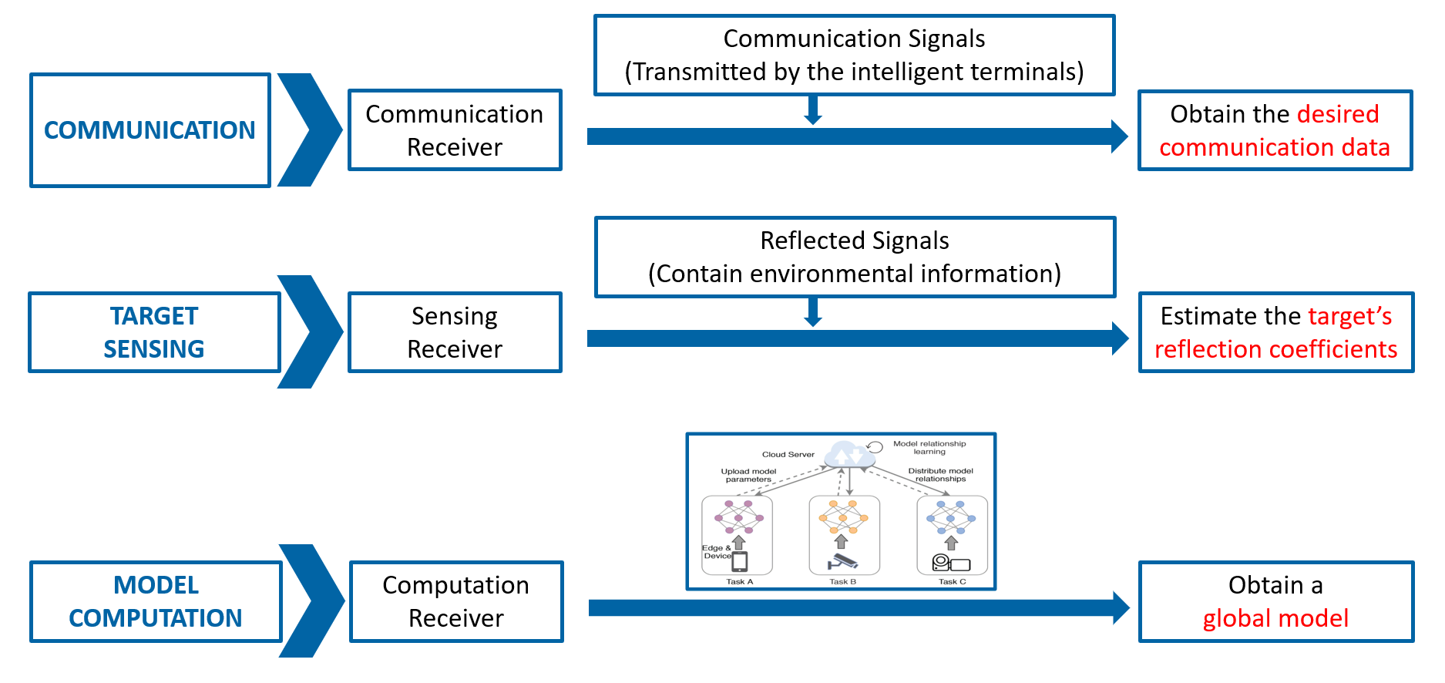
Expected Work Goals
THEORY
Enhance the Communication Performance:
communication speed, latency, utilization, etc.
PRACTICE
Make a real Impact in Real World:
intelligent transportation, IoT, etc.

Slide 9


Thank you for listening!
Team 7
2024年12月26日

